Slide 1

HEALTHCARE SYSTEM
20XX
Big Data Analytics

Slide 2
Goal Of Project
20XX
The goal of the project is to create data pipelines for the Health Care insurance company which will make the company make appropriate business strategies to enhance their revenue by analyzing customers behaviors and send offers and royalties to customers respectively.
.

Slide 3
20XX
Environment
Requirements
Linux (Ubuntu 18.04)
Hadoop 2.7.2
Spark 2.0.2
sqoop 1.4.7
python3
A Health Care insurance company is facing challenges in enhancing its revenue and understanding the customers so it wants to take help of Big Data Ecosystem to analyze the Competitors company data received from varieties of sources, namely through scrapping and third-party sources. This analysis will help them to track the behavior, condition of customers so that to customize offers for them to buy insurance policies and also calculate royalties to those customers who buy policies in past, this in turn will enhance their revenues

Slide 4
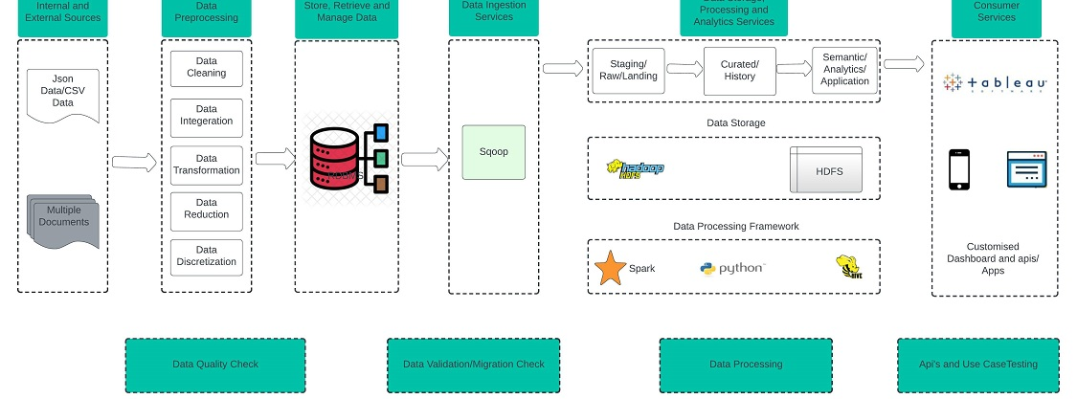
PICTURE SLIDE
20XX

Slide 5
STEPS:
DATASET CREATION
A data set (or dataset) is a collection of data. In the case of tabular data, a data set corresponds to one or more database tables, where every column of a table represents a particular variable, and each row corresponds to a given record of the data set in question. The data set lists values for each of the variables, such as height and weight of an object, for each member of the data set. Each value is known as a datum. Data sets can also consist of a collection of documents or files
DATA CLEANING
Data cleaning is the process of fixing or removing incorrect, corrupted, incorrectly formatted, duplicate, or incomplete data within a dataset. When combining multiple data sources, there are many opportunities for data to be duplicated or mislabeled. If data is incorrect, outcomes and algorithms are unreliable, even though they may look correct. There is no one absolute way to prescribe the exact steps in the data cleaning process because the processes will vary from dataset to dataset
DATABASE CREATION
A database is an organized collection of structured information, or data, typically stored electronically in a computer system. A database is usually controlled by a database management system (DBMS). Together, the data and the DBMS, along with the applications that are associated with them, are referred to as a database system, often shortened to the just a database.
LOADING DATA TO DATABASE
Data loading refers to the "load" component of ETL. After data is retrieved and combined from multiple sources (extracted), cleaned, and formatted (transformed), it is then loaded into a storage system, such as a cloud data warehouse, or relational database.
DATA TRANSFER TO HDFS USING SQOOP
Apache Sqoop is a command-line interface application used for transferring data between relational databases and Hadoop. The focus of this blog is on making the readers thoroughly understand Apache Sqoop and its deployment.

Slide 6
CODE
Links
CLEANING : CLEANING.IPYNB
CONNECTING :Connecting.ipynb
Visualistion :Spark output
Overall :Drive folder

Slide 7

THANK YOU!
20XX
Meghana Kavana

